Slide 1
EATING BEHAVIORS IN THE BARIATRIC PATIENTS
Dr. chandra massetti
Departement of general surgerY, surgical specialities and anesthesiology
La sapienza, rome

Slide 2
TO START…
According to the WHO, obesity is defined as an excessive accumulation of body fat that presents a health risk and is diagnosed with a Body Mass Index (BMI) of 30 kg/m² or higher in adults.
The multifactorial genesis of obesity requires the implementation of integrated treatment programs, aimed at solving the clinical problems that the patient is carrying (Micanti et al. 2016).
As we know, bariatric surgery is the treatment of choice for patients with severe obesity (BMI ≥ 40) or moderate obesity with significant comorbidities (BMI between 35 and 39.9) when diet and other treatments have not worked.
There is now evidence in the literature that bariatric surgery is effective on BED.
There are few studies that investigate into dysfunctional/malaptative eating habits and bariatric surgery.
Importance of the surgeon's need to understand that even knowledge of a dysfunctional eating style, if repeated, can lead to developing an eating disorder.
It is also important to understand how the psychologist's role can work with the person during the bariatric journey to recognize and avoid post-surgical weight regain.

Slide 3
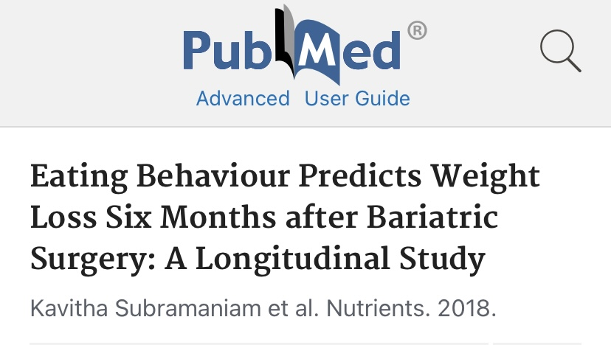
This prospective study included 57 participants undergoing bariatric surgery (laparoscopic Roux-en-Y gastric bypass: n = 30; laparoscopic sleeve gastrectomy: n = 23; anastomosis-mini gastric bypass: n = 4) at two tertiary referral hospitals. Consenting participants were assessed before surgery (T 0), three months (T 1), and six months (T 2) after surgery.
The clinical implication of this finding is that eating behaviors influence weight loss during the acute period of weight loss.
Eating habits have been shown to be important predictors of weight loss six months after surgery.
Continuous assessment of eating habits during pre- and post-operative follow-up is essential to achieving good weight loss outcomes.

Slide 4
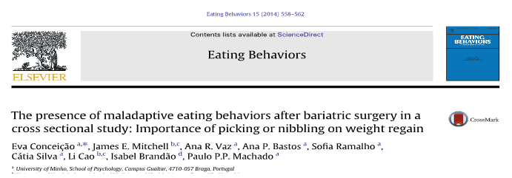
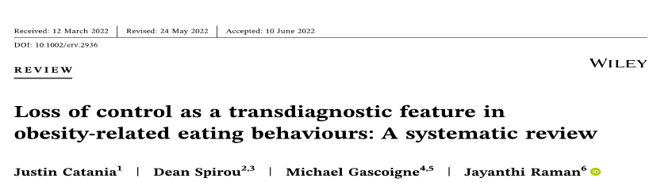

Slide 5
EATING BEHAVIOR
NORMAL EATING BEHAVIOUR
MALADAPTATIVE EATING BEHAVIOUR
EATING DISORDER
DISFUNCTION EATING STYLE

Slide 6
BARIATRIC PATIENTS AND EATING DISORDERS ASSOCIATED
BINGE EATING DISORDER
NIGHT EATING SYNDROME
(Eating Disorders with Other Specification)
BULIMIA
Diagnostic and Statistical Manual of Mental Disorders, Fifth Edition, APA 2013
and W.H.O.

Slide 7
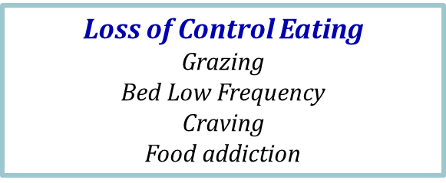
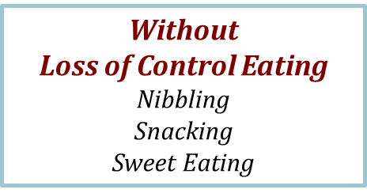
Disfunction Eating Styles
Other Maladaptive Eating Behaviors
(occurring despite objective physical symptoms):
Dumping (predilection for high-sugar foods);
Plugging (failure to eat within the proper size of the pouch: little or no chewing, excessive biting, drinking rapidly, such as when breastfeeding);
Vomiting unrelated to weight control (spontaneous or induced, occurring after surgery, used as a response to physical discomfort related to: plugging, intolerant foods, poor chewing, excessive eating)
C.S. Brode et al. 2019, K.E. Smith et al. 2019

Slide 8
EATING BEHAVIOURS
Disordered eating isn't an "eating disorder". However, it is an abnormal behavior that could become dangerous.
DISFUNCTION EATING STYLE | EATING DISORDERS
Normal food intake | Large food intake
Not associated with psychopathology | associated with psychopathology
Taste recognition | sometimes not taste recognition
not impacts the quality of life and social life | impacts the quality of life and social life
BUT BOTH CAN HAVE THESE CONSEQUENCES:
Emotional distress Demotivation Weight loss stall Weight regain

Slide 9
FOOD ADDICTION, SWEET EATING AND CORRELATED PSYCHOLOGICAL FACTORS FOLLOWING BARIATRIC SURGERY: A MULTICENTRE, RETROSPECTIVE PILOT STUDY. Massetti, C., Rizzo, F., Di Paola, M. ,Paganini, A.M. Departement of General Surgery and Surgical Specialities and Anesthesiology- La Sapienza University, Rome Departement of General Surgery of the San Pietro-Fatebenefratelli Hospital, Rome
Our retrospective study analyzes the prevalence of food addiction and sweet eating in patients undergoing bariatric surgery and inestigates whether these two dysfunctional eating styles are associated with psychological and/or psychopathological factors.
34 patients were included in this analysis, 23 from the Policlinico Umberto I and 9 from the Villa S. Pietro Fatebenefratelli Hospital. The mean age (μ) of the sample was 49.1 ,(n = 26 females, 8 males). Among the participants, 21 of them underwent a sleeve gastrectomy procedure while 14 underwent gastric bypass. Among these, 2 people are taking psychopharmacological therapy with antidepressants.
Methods.
The aim of this study is to assess the transversal associations between Food Addiction, sweet eating and psychological factors, both internalising and externalising, in a retrospectively conducted analysis. This analysis was conducted on a dataset collected retrospectively from January 2024 to June 2024 on patients undergoing bariatric sleeve gastrectomy and gastric bypass procedures operated between 2017 and 2023 at the Policlinico Umberto I’s Department of General and Surgical Specialities, Anestesiology and Center of Excellence for the treatment of Obesity' at the U.O.C. of General Surgery at the San Pietro-Fatebenefratelli Hospital in RomeThe psychometric evaluation consisted of the Eating Behavior Assessmet for Obesity (EBA-O) and Symptom CheckList-90 (SCL-90) tests
SCL-90 (Symptom Checklist 90, De Rogatis, L. 1973) a scale for the self-assessment of general psychic symptoms, consisting of 90 questions that reflect the 9 dimensions that underline most of the symptoms that are observed in those suffering from psychic disorders (somatization, obsessive-compulsive dimension, interpersonal sensitivity, depression, anxiety, hostility, phobic anxiety, paranoid ideation, psychoticism).
EBA-O (Eating Behaviors Assessment for Obesity)(Segura Garcia,C. et al.2022). The questionnaire have a 18-items for the evaluation of 5 major disorganized eating behaviors (food addiction, night eating, binge eating, sweet eating, hyperphagia).

Slide 10
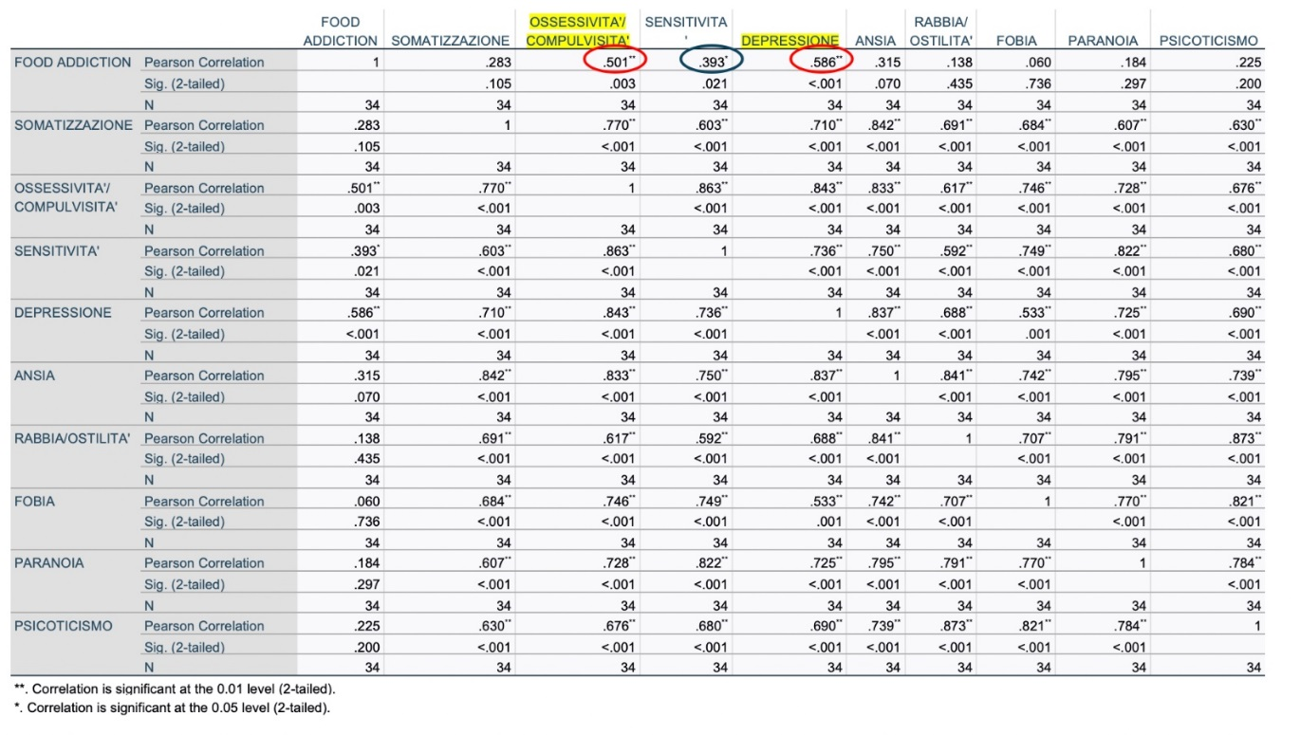
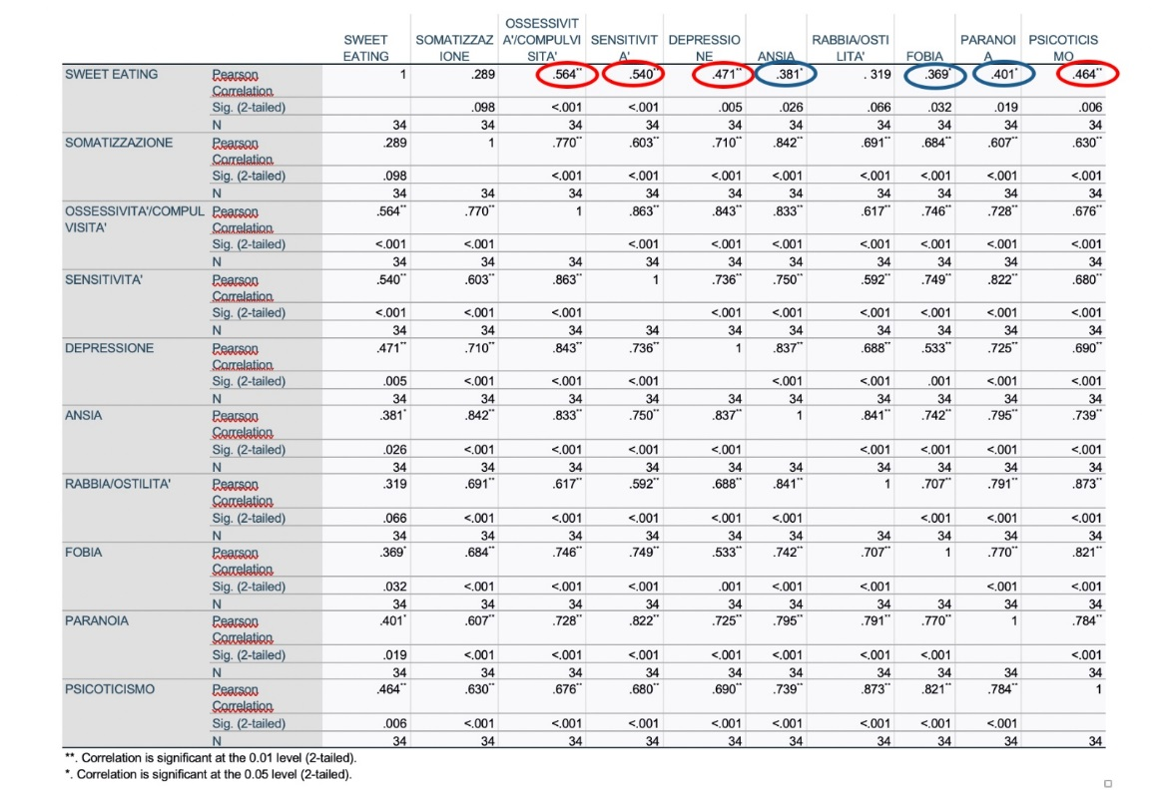
Results:
Highly significant correlations were found between:
the EBA-O Food Addiction and Sweet Eating scales and the SCL-90 Obsessive-Compulsiveness and Depression scales;
- the EBA-O Sweet Eating scale and the SCL-90 Obsessive-Compulsiveness, Depression, Sensitivity, and Psychoticism scales.
Our multicentric retrospective pitot study has highlighted how eating behavior and dysfunctional eating styles such as Food Addiction and Sweet Eating in people with overweight/obesity, correlated to psychological and sometimes even psychopathological factors (depression, obsessive/compulsiveness) are configured as risk elements for weight maintenance during the follow up phase.

Slide 11
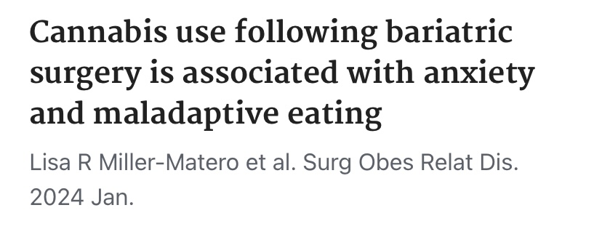
POSSIBLE CONSEQUENCES AFTER BARIATRIC SURGERY
Postsurgical Avoidant Eating Disorder (PSEAD) is closely linked to the fear of weight regain and dietary restrictions, resulting in a marked and lasting change in the "relationship with food."
Different from AN: a "normal weight" BMI often precludes a diagnosis of AN.
It is characterized by greater-than-expected weight loss, fear of weight regain, dietary restrictions, and disturbances in self-perception, body shape, and weight. (Segal et al 2004)
Cannabis use after bariatric surgery was associated with anxiety symptoms and engaging in maladaptive eating behaviors. Frequent cannabis use (i.e., ≥1 per week) is associated with additional types of maladaptive eating. Clinicians involved in presurgical and postsurgical care may want to counsel patients currently using cannabis, especially those who are engaging in frequent use.

Slide 12
TAKE HOME MESSAGES
We must consider that eating behavior is part of the individual's personality and life experience.
Even if the dysfunctional eating style does not impact daily life, it is a behavior that can turn into a disorder or a habit that is difficult to eradicate.
It is important to know and not underestimate dysfunctional eating habits in order to be able to correct them already in the pre-operative phase.
The role of the psychologist is fundamental both in the pre-operative and post-operative phases to avoid consequences both from the nutritional point of view and in other areas.

Slide 13
THANK YOU chandra.massetti@uniroma1.it

